Slide 1
How to Draw a Concept Map
You can either draw a concept map on a piece of paper or on a concept mapping software. Either way, stick to the following steps when you are drawing one.
Step 1: Pick a Topic
The first step is to identify a topic you need to study with your concept map. This could be an idea, a question or an issue.
For example, let’s say you are interested in Muscular System.
Step 2: Do a Quick Brainstorm
What are the facts, ideas, concepts, themes, queries etc. that come to your mind when you think about this topic? Note these down as you brainstorm around the topic you have selected. Remember to keep these as concise as possible. See below for the start of an example
Step 3: Start to Draw the Map
It’s recommended to start a concept map from the top and develop it downward, although you can put down your topic at the center and expand it outwards. Either way make sure that the central topic stands out from the rest (use a bigger node, a different color etc.).
Step 4: Connect the Concepts
Now it’s time to connect what you have brainstormed to the central topic and to each other. Remember, the more important the idea, the closer it should be to the top or the center.
As you identify these connections put down the linking words or phrases to indicate the relationship between the two concepts you are linking.
Once the direct connections between concepts have been identified, look for crosslinks that link together concepts from different areas or domains.
Types of muscle | Function of muscle | Type I | Type Iia | Type IIx
concentric | Force | Contraction speed | Mitochondria | myoglobin#
Eccentric | Isometric | Striated | Fatiguing | Non-fatiguing
Aerobic capacity | Anaerobic capacity | Hypertrophy | Muscle fibre tears | Lactate build up
Resistance to lactate | Cramp | Age | Pliability | Own blood supply

Slide 2
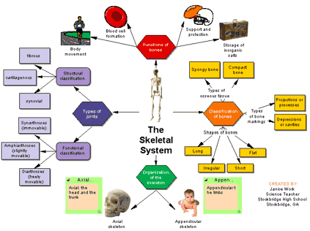

Slide 3
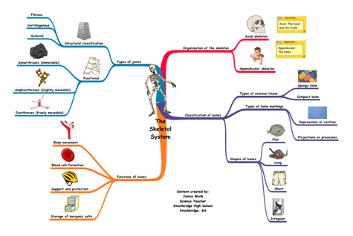

Slide 4
